Slide 1


Fast Random Walk with Restart and Its Applications
Hanghang Tong, Christos Faloutsos and Jia-Yu (Tim) Pan
ICDM 2006 Dec. 18-22, HongKong
Notes:
ICDM2006 Dec, 18-22, HongKong
Well thank you for coming, I am hanghang, from CMU. Today, I will introduce our work on Fast Random walk with Restart and Its Applications. This is the joint work with Christos and Tim.

Slide 2
Motivating Questions
Q: How to measure the relevance?
A: Random walk with restart
Q: How to do it efficiently?
A: This talk tries to answer!
Notes:
ICDM2006 Dec, 18-22, HongKong
There are increasingly interest in Graph Mining. Among many others, one fundamental question is that how to measure the relevance/closeness of two nodes in the graph.
Well, while many recent work suggests that random walk with restart might be a good candidate, how to compute this score efficiently remains a question. We will try to address the scalability of the random walk with restart in this talk—how can we compute this score efficiently?

Slide 3
Random walk with restart
10
9
12
2
1
8
3
11
4
6
5
7
Notes:
ICDM2006 Dec, 18-22, HongKong
So, what is random walk with restar.t let us start with an illustrative example.
Suppose in the example, we want to measure the relevance score for every node j wrt node 4. To this end, we simulate a random walk with restart for node 4, that is, suppose a random particle starts from node 4, at each step,it will jump to its neighborhood with the probability that is proportional to the edge weight between them; also at each step, it has some small probability, 1-c, to return to the starting point 4. The relevance score for node j wrt node 4 is defined as the steady-state probability that the random particle will finally stay at node j.
Here is some animation, to illustrate how random walk with restart works, we use the dash arrow to denote restart. Basically, it is a random, but with restart.

Slide 4
Random walk with restart
10
9
12
2
1
8
3
11
4
6
5
7
Notes:
ICDM2006 Dec, 18-22, HongKong
So, what is random walk with restar.t let us start with an illustrative example.
Suppose in the example, we want to measure the relevance score for every node j wrt node 4. To this end, we simulate a random walk with restart for node 4, that is, suppose a random particle starts from node 4, at each step,it will jump to its neighborhood with the probability that is proportional to the edge weight between them; also at each step, it has some small probability, 1-c, to return to the starting point 4. The relevance score for node j wrt node 4 is defined as the steady-state probability that the random particle will finally stay at node j.
Here is some animation, to illustrate how random walk with restart works, we use the dash arrow to denote restart. Basically, it is a random, but with restart.

Slide 5
Random walk with restart
10
9
12
2
1
8
3
11
4
6
5
7
Notes:
ICDM2006 Dec, 18-22, HongKong
So, what is random walk with restar.t let us start with an illustrative example.
Suppose in the example, we want to measure the relevance score for every node j wrt node 4. To this end, we simulate a random walk with restart for node 4, that is, suppose a random particle starts from node 4, at each step,it will jump to its neighborhood with the probability that is proportional to the edge weight between them; also at each step, it has some small probability, 1-c, to return to the starting point 4. The relevance score for node j wrt node 4 is defined as the steady-state probability that the random particle will finally stay at node j.
Here is some animation, to illustrate how random walk with restart works, we use the dash arrow to denote restart. Basically, it is a random, but with restart.

Slide 6
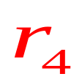
Random walk with restart
 | Node 4
Node 1 Node 2 Node 3 Node 4 Node 5 Node 6 Node 7 Node 8 Node 9 Node 10 Node 11 Node 12 | 0.13 0.10 0.13 0.22 0.13 0.05 0.05 0.08 0.04 0.03 0.04 0.02
0.04
0.03
10
0.10
9
12
0.13
2
0.08
0.02
1
8
0.13
11
3
0.04
4
0.05
6
5
0.13
7
Ranking vector
0.05
Notes:
ICDM2006 Dec, 18-22, HongKong
OK, so here is the final score. It can be seen that the score is consistent with our intuition, that is nearby points receive higher score.
putting all those score to into a vector, we get the ranking vector r_4

Slide 7
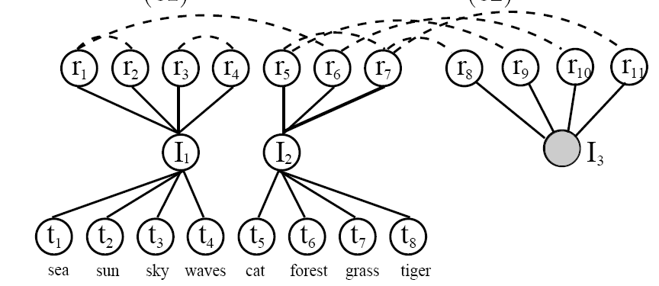
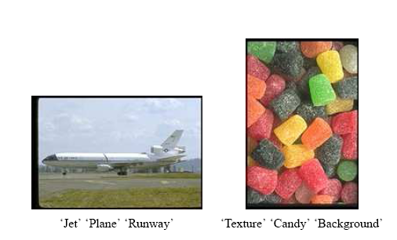
Automatic Image Caption
Region
[Pan KDD04]
Image
Test Image
Text
Jet Plane Runway
Candy
Texture
Background
Notes:
ICDM2006 Dec, 18-22, HongKong
Now, let’s see some applications examples of random walk with restart.
First one is automatic image caption: Given an image, how can we automatically assign key word terms.
Well, Pan in kdd2004 suggested using random walk with restart. Here are two examples, the text terms are automatically annotated by their alg.

Slide 8
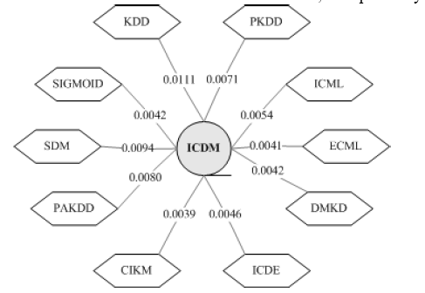
Neighborhood Formulation
[Sun ICDM05]
Notes:
ICDM2006 Dec, 18-22, HongKong
Here is another application: given a node in the graph, what is its neighborhood. In Sun’s work, they also suggest to use random walk with restart. For example, given an author-conference bipartite graph, we can find 10 most related conference for ICDM, such as KDD, SDM, ICDE so on and so forth.

Slide 9
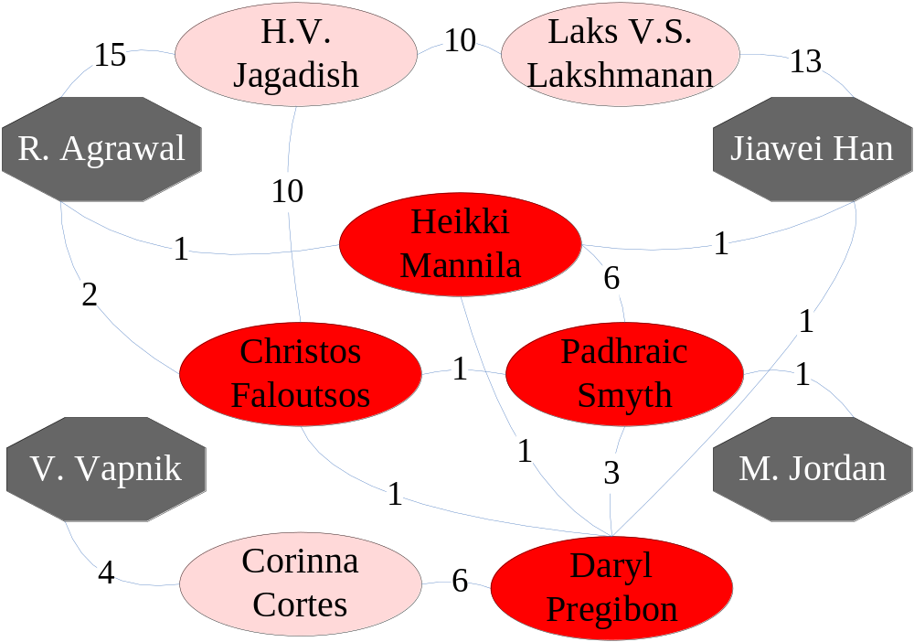
Center-Piece Subgraph
[Tong KDD06]
Notes:
ICDM2006 Dec, 18-22, HongKong
In our own recent work, the so-called center-piece subgraph, random walk with restart, again plays as a building block. (That is, given some query nodes and budget in the graph, we want to find the nodes and resulting subgraph that have strong connection to all/most of the query nodes. For ) Here is an example, given four researchers, Agrawal, Han, Vapnik and Jordan in an authorship network, their center-piece subgraph could be this.

Slide 10
Other Applications
Content-based Image Retrieval
Personalized PageRank
Anomaly Detection (for node; link)
Link Prediction [Getoor], [Jensen], …
Semi-supervised Learning
….
[Put Authors]
Notes:
ICDM2006 Dec, 18-22, HongKong
We can enumerate many other examples, where rwr plays as a building block, such as content-based image retrieval, personalized pagerank, anomaly detection, link prediction and so on. For the time limited, we will skip them here.

Slide 11
Roadmap
Background
  RWR: Definitions
  RWR: Algorithms
Basic Idea
FastRWR
  Pre-Compute Stage
  On-Line Stage
Experimental Results
Conclusion
Notes:
ICDM2006 Dec, 18-22, HongKong
Here is the roadmap, we have already covered the background.

Slide 12
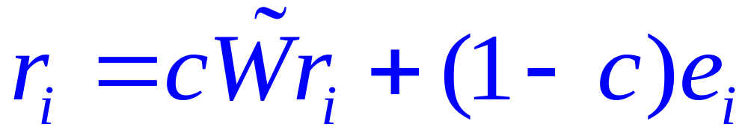
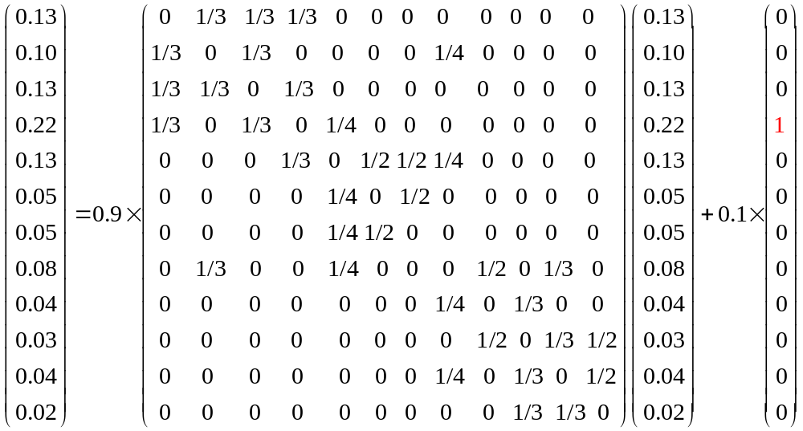
Computing RWR
Ranking vector
Adjacent matrix
starting vector
9
10
1
12
2
1
8
3
11
4
5
6
7
n x 1
n x n
n x 1
Q: Given ei, how to solve?
Notes:
ICDM2006 Dec, 18-22, HongKong
So far it’s good. Now, let’s turn to the computational issue of rwr. (Well, here is the definition of rwr. (Given a query node i, how can we compute its relevance score with every other node j, in other words, how can we can the ranking vector r_i;)
OK, here is the definition of random walk with restart, such that r is n x 1, where n is the # of the nodes in the graph, ranking vector, W-tuda is n x n normalized adjacent matrix, e_i is n x 1 starting vector, and 1-c is the restarting prob. by setting the different starting vector, we can get the different ranking vector for different query node (For example, setting the 4^th element of e_i to be 1 and 0 for all others, we can get the ranking vector query node 4.)
So, given a query node, or equivalently given a starting vector, how can we solve this linear system?

Slide 13
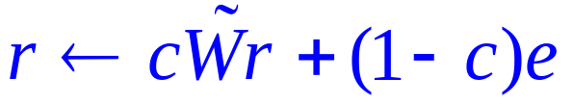
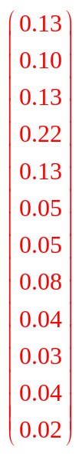
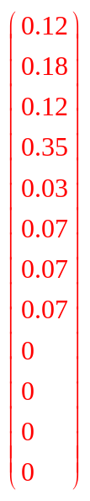


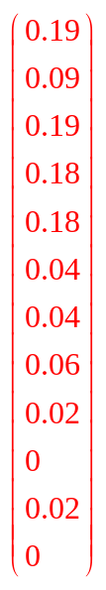
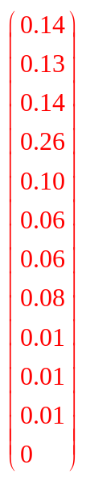
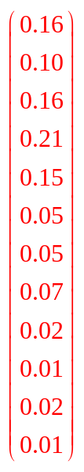
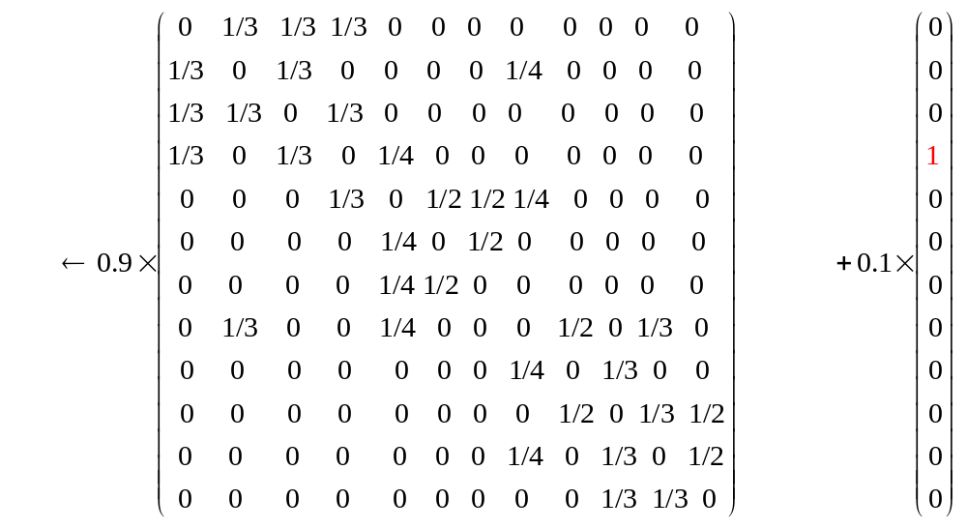





OntheFly:
0.04
10
0.03
9
10
0.10
9
12
0.13
2
2
0.08
12
1
8
0.02
1
8
11
3
11
3
0.13
0.04
4
4
6
0.05
5
5
6
0.13
7
7
0.05
No pre-computation/ light storage
Slow on-line response
O(mE)
Notes:
ICDM2006 Dec, 18-22, HongKong
One of the most widely used method to solve rwr is the iterative method, iterate this equation many times until convergence in the on-line query stage. We call it OntheFly.
For example, in this graph, to compute the ranking vector, for query node 4, we first, set the ranking vector r to be equal to starting vector e, and then, we iterate this equation many times . After convergence, we will get the ranking vector.
(The good news about this method is that it does not require any pre-computation, and we only need to store the adjacent matrix W-tuda. )However, for this method, its speed is linear to the # of edge in the graph. For the large scale problem, this mightbe not desirable.

Slide 14


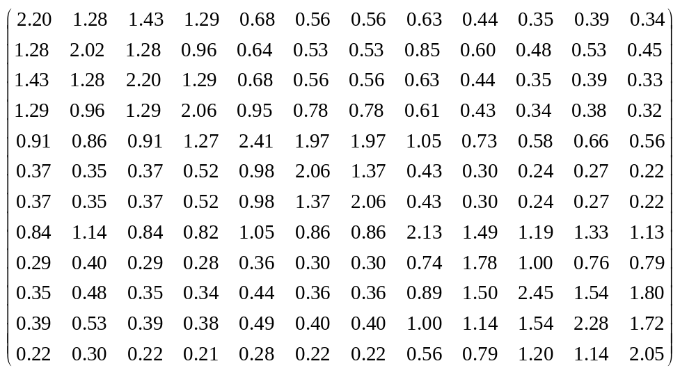

PreCompute:
0.04
10
0.03
9
10
0.10
9
12
0.13
2
0.08
12
2
8
0.02
1
8
1
11
3
0.13
11
3
0.04
4
4
6
0.05
5
6
5
0.13
7
7
0.05
Fast on-line response
Heavy pre-computation/storage cost
O(n^3)
O(n^2)
Notes:
ICDM2006 Dec, 18-22, HongKong
On the other extreme, if we can pre-compute and storage the so-called Q matrix, which is the inverison of I-cW-tuda, we can get the ranking vector in real time. We refer it as PreCompute.
For example, If we have pre-computed and stored the Q-matrix for this graph, in the on-line stage, basically, we only need to read out the corresponding column of q-matrix.
However, when the graph is large (hundreds of thousands of node), pre-computing and storing the inversion of a large matrix, is very expensive.

Slide 15


Q: How to Balance?
On-line
Off-line
Notes:
ICDM2006 Dec, 18-22, HongKong
So, the big challege here is that, How to balance between the two sides: the off-line pre-computation/storage cost and the on-line response speed?

Slide 16
Roadmap
Background
  RWR: Definitions
  RWR: Algorithms
Basic Idea
FastRWR
  Pre-Compute Stage
  On-Line Stage
Experimental Results
Conclusion
Notes:
ICDM2006 Dec, 18-22, HongKong
Here is the roadmap, we have already covered the background.

Slide 17
Basic Idea
Find Community
2
1
3
4
10
0.04
9
10
0.03
9
0.10
9
10
12
2
12
0.13
0.08
12
2
2
0.02
8
1
8
1
8
1
11
0.13
11
3
11
3
3
Combine
0.04
4
4
4
0.05
5
6
6
5
6
0.13
5
7
0.05
7
7
10
9
12
8
Fix the remaining
11
5
6
7

Slide 18
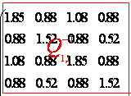
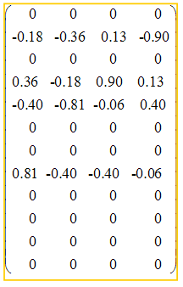
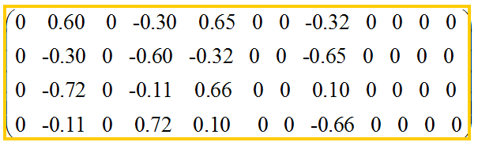

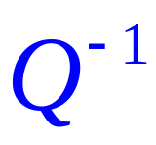
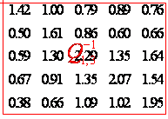
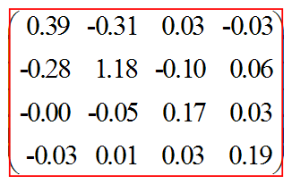

Basic Idea: Pre-computational stage
A few small, instead of ONE BIG, matrices inversions
Q-matrices
Link matrices
+
U
V
Notes:
ICDM2006 Dec, 18-22, HongKong
the basic idea of our fast rwr is in two folds,
First, in the pre-computational stage, intead of one big matrix inversion, we compute and store a few but much smaller, together with two extra matrices, U,V, so that, based on those matrices, we can quickly approx the original whole Q-matrix

Slide 19


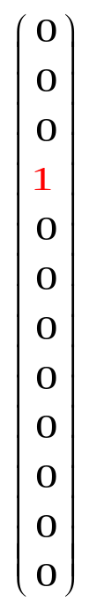

Basic Idea: On-Line Stage
A few, instead of MANY, matrix-vector multiplication
V
+
U
+
Query
Result
Notes:
ICDM2006 Dec, 18-22, HongKong
On the other hand, in the on-line query stage, given a query node I, or equivalent given a starting vector e_i, we want quickly output its ranking vector r_i by only a few, Instead of MANY, matrix-vector multiplication.

Slide 20
Roadmap
Background
Basic Idea
FastRWR
  Pre-Compute Stage
  On-Line Stage
Experimental Results
Conclusion
Notes:
ICDM2006 Dec, 18-22, HongKong
Now, let us see the alg in detail, first, the pre-computation stage.

Slide 21


Pre-compute Stage
p1: B_Lin Decomposition
  P1.1 partition
  P1.2 low-rank approximation
p2: Q matrices
  P2.1 computing (for each partition)
  P2.2 computing (for concept space)
Notes:
ICDM2006 Dec, 18-22, HongKong
In the pre-computation stage, there are mainly two steps. First, we perform the block-linear,B_Lin, decomposition, and then, compute and store a few small matrices inversion

Slide 22
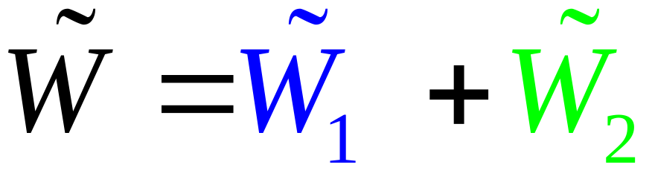
P1.1: partition
9
10
2
12
9
10
1
8
2
12
3
11
1
8
4
3
11
5
6
4
5
6
7
7
Within-partition links
cross-partition links
Notes:
ICDM2006 Dec, 18-22, HongKong
First, we do graph partition, and re-arrange the adjacent matrix W-tuda into two matrices: W1-tuda containing all within-partition links and W2-tuda contains all cross-partition links.
For example, if we partition this graph into three pieces, then, the blue links are within-partition links and the green links are cross-partition links.

Slide 23
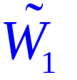
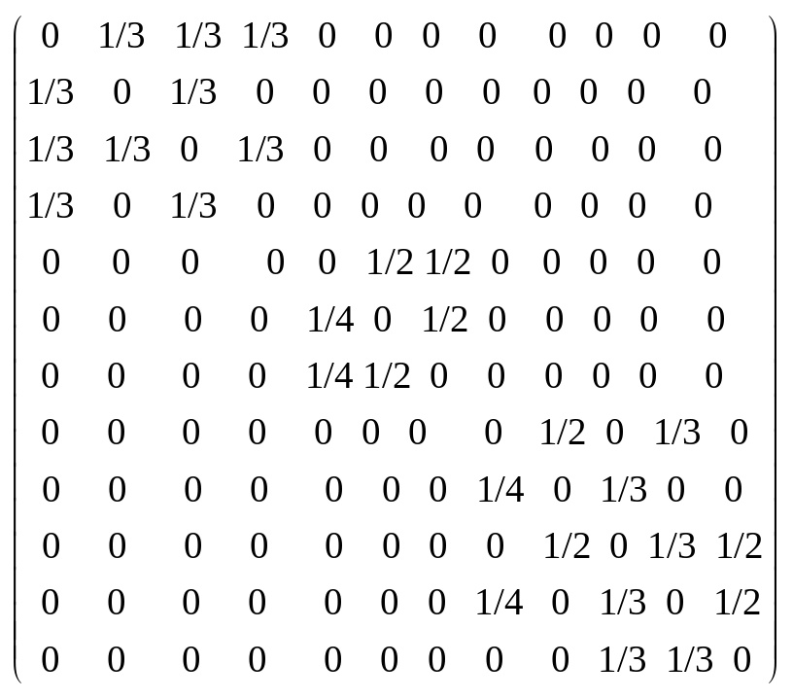

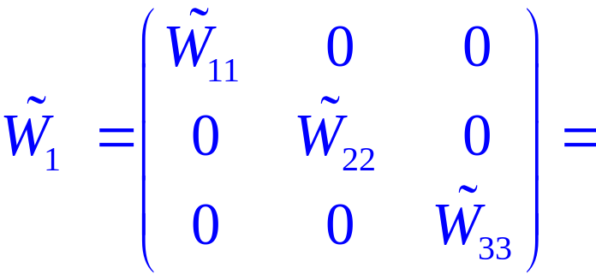

P1.1: block-diagonal
10
9
10
9
12
2
12
2
8
1
8
1
11
3
11
3
4
4
6
5
6
5
7
7
Notes:
ICDM2006 Dec, 18-22, HongKong
Note that for within-partition matrix W1-tuda, it has a block-diagonal structure: each diagonal piece corresponds to a single partition

Slide 24

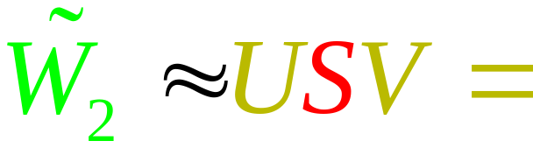
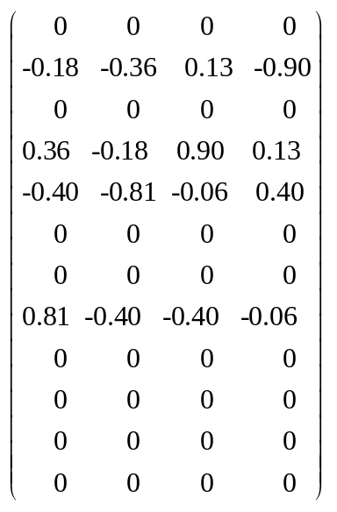
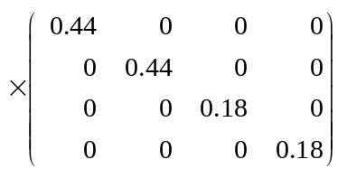
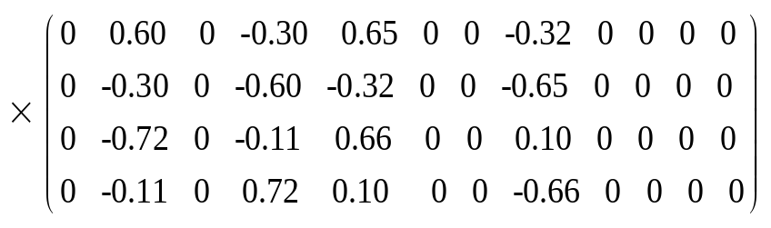
P1.2: LRA for
10
9
10
9
12
2
12
2
8
1
8
1
11
3
11
3
4
4
6
5
6
5
7
7
S
V
U
Notes:
ICDM2006 Dec, 18-22, HongKong
For the cross-partition link matrix W2-tuda, we perform a low-rank approximation for it, that is, we approx W2-tuda by three matrices U,S,V.
(By low-rank approximation, we actually introduce a hidden concept space. And consequently, the cross-partition links W2-tilde is approximated by node-concept and concept-concept relationship.
For example, in the graph, if we use a 4-rank approximation for the cross-partition matrix W2-tilde, we actually introduce a hidden concept space with 4 elements, c1-c4. and the S-matrix, the red links, describle the concept-concept relationship. While U/V-matrices, the yellow links, describe the node-concept/concept-node relationship.)

Slide 25
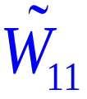



2
10
9
10
1
9
12
3
12
2
4
8
1
8
c2
11
3
11
4
c1
c3
5
6
c4
7
6
5
7
S
V
+
U
Notes:
ICDM2006 Dec, 18-22, HongKong
To summarize, by B_Lin, we will decompose the original adjacent matrix into a block-diagonal matrix, W1-tuda, plus a low-rank approximation structure, U,S,V.
(For those are familiar with latent If you are familiar with latent semantic space. Here is an intuition: )

Slide 26
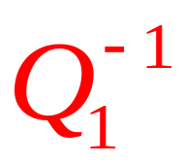

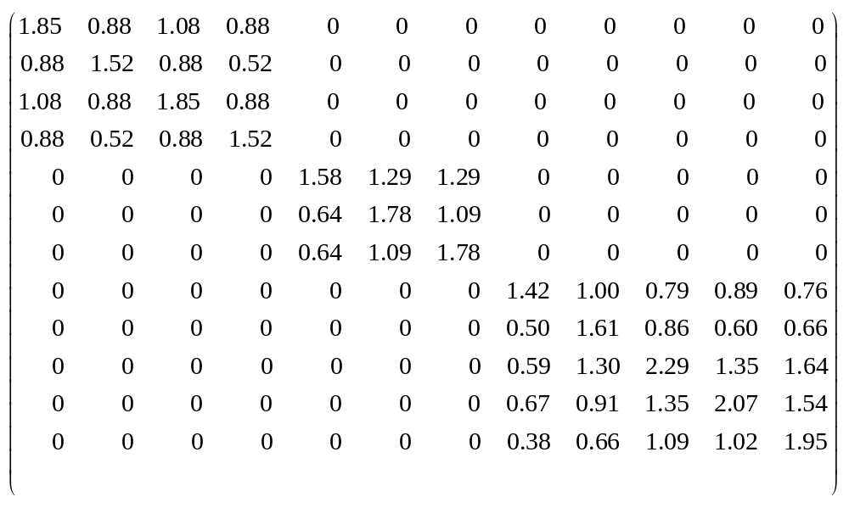



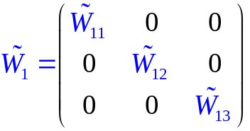
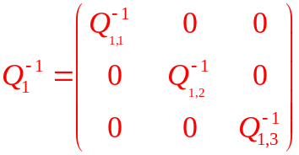
p2.1 Computing
Notes:
ICDM2006 Dec, 18-22, HongKong
Then, we compute the Q-matrix for the within-partition matrix W1-tuda, we call it Q1^-1. Note that, since W1-tuda has block-diagonal structure, we can do the inversion for each block piece and put final results together.

Slide 27
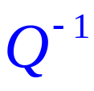
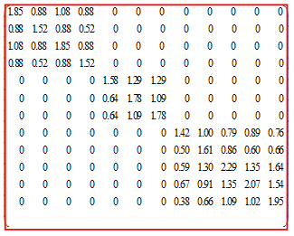

Comparing and
Computing Time
  100,000 nodes; 100 partitions
  Computing 100,00x is Faster!
Storage Cost (100x saving!)

Slide 28
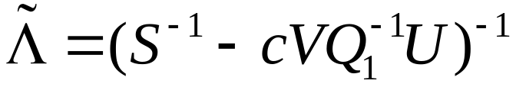


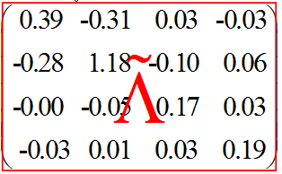
p2.2 Computing:
-1
_
=
V
U
9
10
2
12
1
8
3
11
4
5
6
7
Notes:
ICDM2006 Dec, 18-22, HongKong
Based on Q1^-1, we perform a non-obvious step, computing another q-matrix lamda-tuda by this equation. We wil explain the reason in the next slide
Note that lamda-tuda is the same size as matrix S so that it can be efficiently be computed and stored. For example, in this graph, if we performe a rank-4 approx for W2-tuda, lamda-tuda is just a 4 x 4 matrix

Slide 29
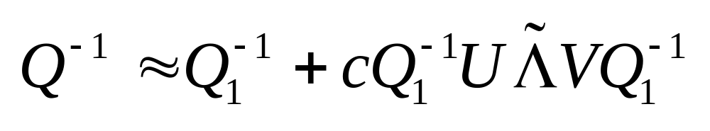
We have:
Q-matricies
Link matrices
V
U
SM Lemma says:
Notes:
ICDM2006 Dec, 18-22, HongKong
So, now, we have pre-compute and store the matrix Q1^-1, lamda-tuda, U, and V. note that since Q1^-1 is block-diagonal, we can just store its diagonal pieces intead.
So, why do we bother, well, the SM lemma tells us that, once we have gotten those matrices, we can quickly approx the original Q-matrix by this equation.

Slide 30
Roadmap
Background
Basic Idea
FastRWR
  Pre-Compute Stage
  On-Line Stage
Experimental Results
Conclusion
Notes:
ICDM2006 Dec, 18-22, HongKong

Slide 31
On-Line Stage
Q
V
?
+
U
+
Query
Result
A (SM lemma)
Notes:
ICDM2006 Dec, 18-22, HongKong
Given a starting vector e_i, in the on-line stage, how can we quickly output the ranking vector r_i
Well, given those pre-computed matrices, ranking vector r_i is determined by this simple equation

Slide 32
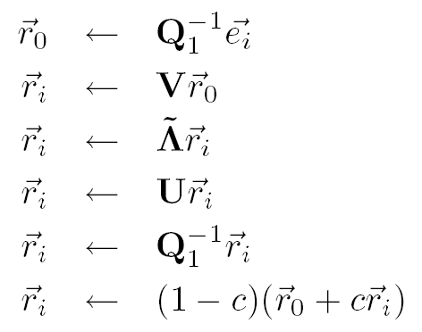
On-Line Query Stage
q1:
q2:
q3:
q4:
q5:
q6:
Notes:
ICDM2006 Dec, 18-22, HongKong
Furthermore, this equation can be decomposed into the following 6 steps.

Slide 33
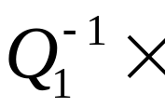




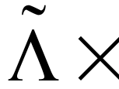
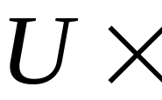
q1: Find the community
q6: Combine
(1-c)
+
c
q2-q5: Compensate out-community Links
Notes:
ICDM2006 Dec, 18-22, HongKong
Here is the flowchart. Compared with onthefly alg, there is no loop, and the whole process is just a few matrices-vector multiplication. So that we can output the result quickly!
To get some intuition, let us see an example.

Slide 34
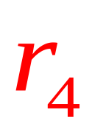
Example
9
10
2
12
1
8
3
11
4
We have
5
6
7
V
+
U
we want to:
Notes:
ICDM2006 Dec, 18-22, HongKong
Again, in this graph, given those pre-computed matrices. How can we get the ranking vector for query node 4.

Slide 35

q1:Find Community
10
9
2
12
2
1
8
1
11
3
3
4
4
5
6
7
q1:
Notes:
ICDM2006 Dec, 18-22, HongKong
Well, in q1, we figure out which community/partition does the query node 4 belong to, and focus only on those links that are within this community
To this end, we just read out the 4^th column of Q1^-1 matrix to get vector r_0.

Slide 36





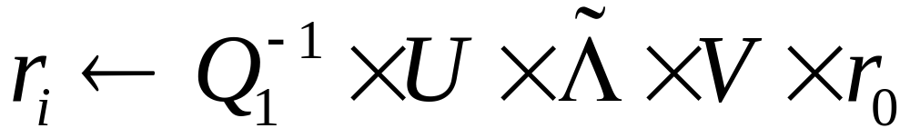


q2-q5: out-community
9
10
2
12
1
8
3
11
4
5
6
7
q4:
q3:
q2:
Notes:
ICDM2006 Dec, 18-22, HongKong
From q2 to q5, we try to compensate the influence of those out-side links. To this end, we multiply by previous vector r_0 by a few matrices, sequentially.
So, first, we multiply it by matrix V, then lamda-tuda, U and then q1^-1

Slide 37
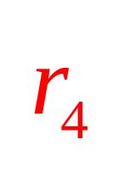
q6: Combination
9
10
12
0.04
0.03
8
0.10
9
10
11
2
0.13
2
0.08
12
1
1
8
0.02
3
3
0.13
11
6
0.04
5
4
4
5
6
0.05
7
0.13
7
0.05
+
0.9
0.1 =
q6:
Notes:
ICDM2006 Dec, 18-22, HongKong
Finally, in q6, we combine the results from two sides together to

Slide 38
Roadmap
Background
Basic Idea
FastRWR
  Pre-Compute Stage
  On-Line Stage
Experimental Results
Conclusion
Notes:
ICDM2006 Dec, 18-22, HongKong
Here is the roadmap, we have already covered the background.

Slide 39
Experimental Setup
Dataset
  DBLP/authorship
  Author-Paper
  315k nodes
  1,800k edges
Quality: Relative Accuracy
Application: Center-Piece Subgraph
Notes:
ICDM2006 Dec, 18-22, HongKong
Now let us see some experimental results. We use the author-paper info from dblp dataset to construct an authorship graph, totally, we have about 300K nodes and about 2 million edges. We test the center-piece subgraph. And since we donot have the ground-truth, we treat the result by OnTheFly method as baseline and report the reletive accuracy as the approximation quality.

Slide 40
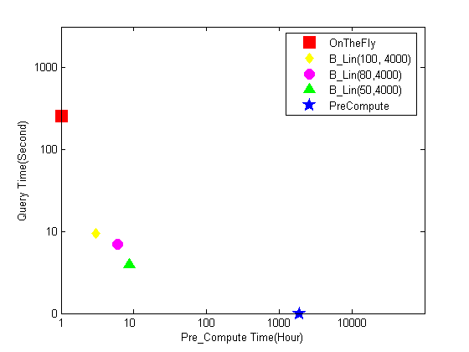

Query Time vs. Pre-Compute Time
Log Query Time
Log Pre-compute Time
Notes:
ICDM2006 Dec, 18-22, HongKong
First, Let’s see how does the alg. Balance between the on-line query time and pre-computational time.
So, x-axes is pre-compute time and y-axes is on-line query time
Notice that, both axes are in log-scale.
Ideally, we want an algorithm that lies in origin. So, here is the results for the two straight-forward methods.
The red square for onthefly and blue star for pre-computational time. It can be seen that neither of them meets our requirements.
Now, here is the results for our algorithm with different parameters. We can see that they achieve a good balance between two sides.

Slide 41
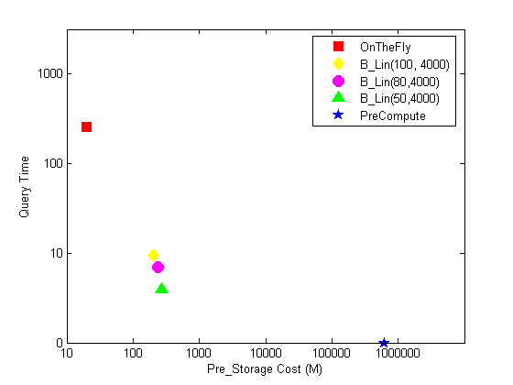
Query Time vs. Pre-Storage
Log Query Time
Log Storage
Notes:
ICDM2006 Dec, 18-22, HongKong
For on-line query time and pre-storage cost, we can observe a similar results.

Slide 42
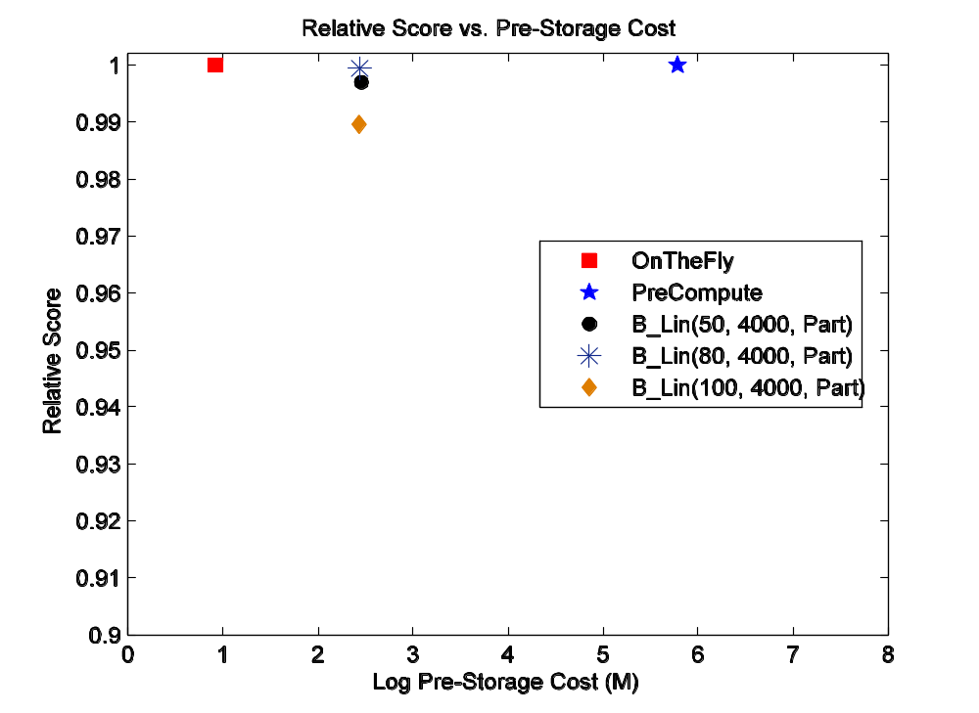


quality
quality
Log Storage
Log Pre-compute
quality
Several orders save in
  pre-storage/computation
Up to 150x faster response
90%+ quality preserving
Log Query Time
Notes:
ICDM2006 Dec, 18-22, HongKong
We report three kinds of curve: the first one is quality vs. pre-storage cost, the second one is quality vs. pre-computational time, and the final one is quality vs. on-line query time. (Notice that the horizontal axes is in log scale.) Ideally, we want an alg. That lies in the left-up zone in all three figures.
So, here is the results for the two straight-forward methods, red square for OntheFly and blue star for PreCompute. It can be seen that neither of them meets our requirment. For example, for OntheFly, its on-line response time is not satisfactory as expected.
Here is results for the proposed alg. with different parameters(, marked by red circle, Notice that they lie in up-left zones in all 3 figure, which ) it can be seen that our alg. achieves a good balance between the pre-computational/storage cost and the on-line response time.( To be specific, with more than 90% quality preserving, we save several orders’ pre-computational and storage cost, and achieve up to 150x speed-up in terms of on-line response.)

Slide 43
Roadmap
Background
Basic Idea
FastRWR
  Pre-Compute Stage
  On-Line Stage
Experimental Results
Conclusion
Notes:
ICDM2006 Dec, 18-22, HongKong
Here is the roadmap, we have already covered the background.

Slide 44
Conclusion
FastRWR
  Reasonable quality preservation (90%+)
  150x speed-up: query time
  Orders of magnitude saving: pre-compute & storage
More in the paper
  The variant of FastRWR and theoretic justification
  Implementation details
    normalization, low-rank approximation, sparse
  More experiments
    Other datasets, other applications
Notes:
ICDM2006 Dec, 18-22, HongKong
Well, a quick conclusion, we propose a fast algorithm for rwr. It carefully balances between the off-line cost and on-line response speed.
For the time limited, we have skipped some details. You can find them in the paper,
for example, the variant of the proposed alg and some theoretic justification, the implementation details and so on

Slide 45
Q&A
Thank you!
htong@cs.cmu.edu
www.cs.cmu.edu/~htong
Notes:
ICDM2006 Dec, 18-22, HongKong

Slide 46
Future work
Incremental FastRWR
Paralell FastRWR
  Partition
  Q-matraces for each partition
Hierarchical FastRWR
  How to compute one Q-matrix for

Slide 47
Possible Q?
Why RWR?
Notes:
ICDM2006 Dec, 18-22, HongKong
Well this is a very good point. RWR has some good properties, such as, it captures the multiple facet relationship between two nodes, which is very important for some graph, such as social network. It punishes the long path in the graph, so the nearby points will receive higher score as we see in the first example. In machine learning community, people augur that rwr can capture the so-called manifold structure.

